Slide 1
Graphical User Interfaces
A.k.a. GUI’s

Slide 2
Announcements:
If you want to discuss your Lab 2 grade come see me this week.
Office: 436 ERB. One hour prior to class
Open to Appointments MWF
I need the hours you spent on your Lab 2
Lab 3 will be graded soon
Lab 4 will be assigned sooner
Questions?
“How to Program Java” By Deitel covers more GUI stuff than the text’s listed on the syllabus

Slide 3
Graphical User Interfaces
What are they?
What’s the difference between a GUI and a console based application?
What is a framework?
A process that uses specific objects
Analogous to a car manufacturing process that uses specific car parts.

Slide 4
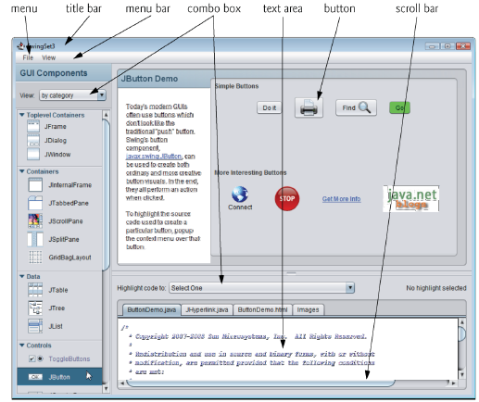
What’s in a GUI?
Answer: A bunch of objects!

Slide 5
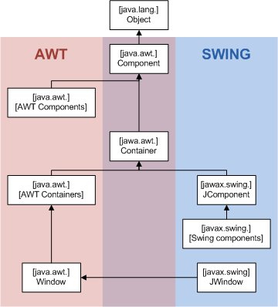
The Java GUI framework
Abstract Windowing Toolkit (AWT)
Built on the native OS
More flexible
Faster
Can be used in browsers without a java plugin
Swing
Newer – built on AWT(ish). Made completely in Java
More Portable
Easier to use
Can use the ‘Model View Control’ design process

Slide 6
Java’s Swing
“Swing is a platform-independent, Model-View-Controller GUI framework for Java, which follows a single-threaded programming model.^{[3]”}
Components –buttons, panels, dialog boxes, menus, text fields, and lists, are the visual widgets that respond to user actions
Swing Components have, ‘J’ in front of them
JFrame
JTextField
Components appear in a container, which are themselves a type of component
Notes:
What is a framework

Slide 7
Swing
The JComponent class is the root of the swing component hierarchy
All swing components are subtypes of this except for top-level containers such as frames

Slide 8
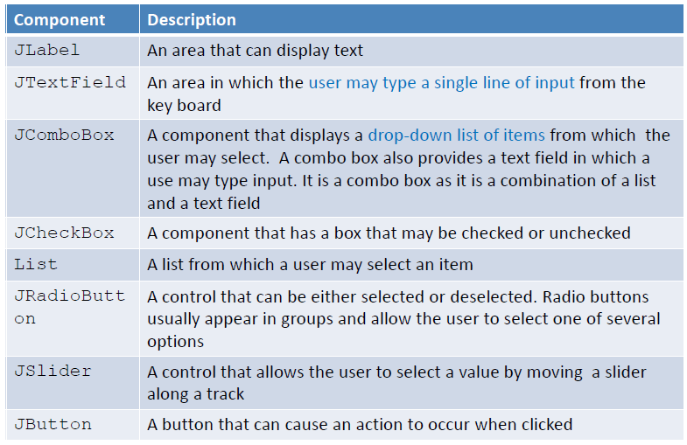
More Swing Components

Slide 9
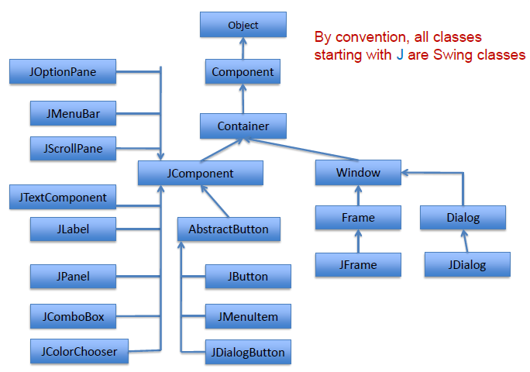
Hierarchical View

Slide 10
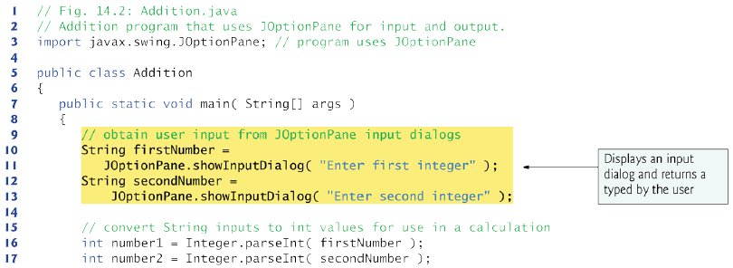
Quick Example

Slide 11
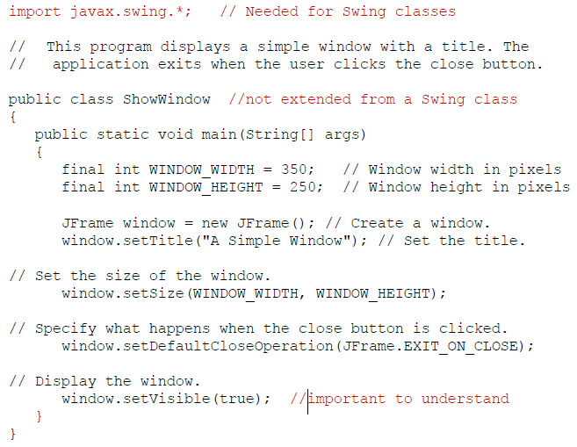

Slide 12
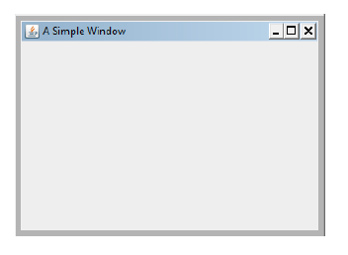
Creates a Simple Window

Slide 13
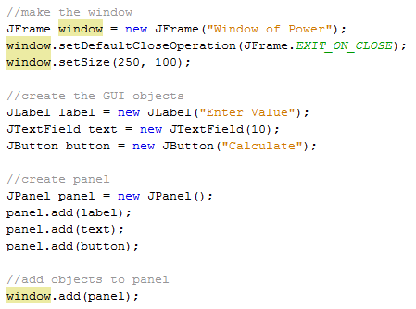
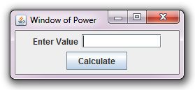
Sweet… A window… now what?
We add some objects

Slide 14
Events
When the button is clicked an Event Object is generated
We handle this with an ActionListener Class

Slide 15
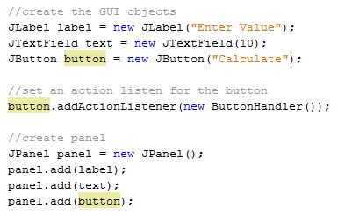
Action Listeners

Slide 16
Mini Review
So far the Process is:
Make a window (called a JFrame)
Add stuff to that window
Make the window visible (most important step)
Create an ActionListener
Register the ActionListener

Slide 17
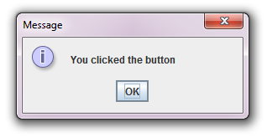
Example Time!

Slide 18
So… what are we doing again?
Extend/make a JFrame
Add a button
Make an class that implements ActionListener
Give that class to the button
Sound good? Any Issues?
Lets call our Jframe ‘window’
And our ActionListener buttonListener
How does the buttonListener access information/methods in the window object?

Slide 19
What was that ‘Private inner class’ stuff?

Slide 20
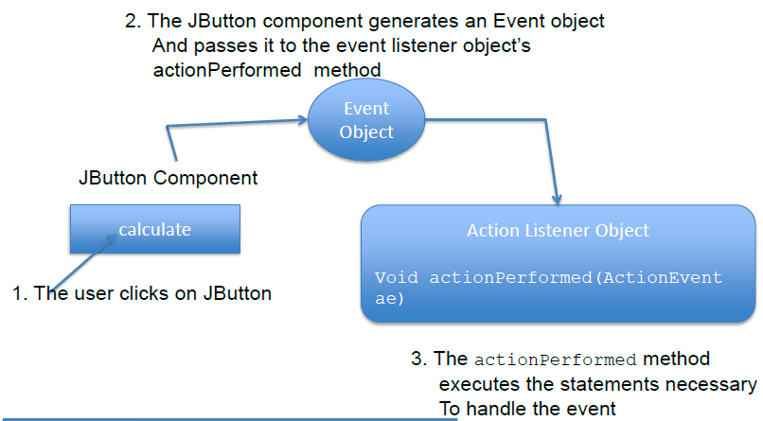
What Happens:

Slide 21
What was all that ‘panel’ stuff?
Pane
A content pane is a container that is part of every Jframe object
You cannot see the content pane and it does not have a border, but any object that is to be displayed in a Jframe must be added to the content pane
Panel
A panel is also a container that can hold GUI components
Unlike Jframe objects, panels cannot be displayed by themselves
commonly used to hold and organize collections of related components
You can add a panel to the content pane (Like we did in the example)
Effectively we added a panel to a pane
Notes:
Home work

Slide 22
Java’s Event Model
An event is an action that takes place within the program
Pressing a button
Hitting ‘Enter’ in a text field
An Event object contains information about the event
The component that generated the event object is known as the Event Source
Jbutton is an event source
Can have multiple listeners
Event objects are automatically passed, as an argument, to the method of the event listener
This process is called ‘Event Firing’

Slide 23
Java’s Event Model
An event source notifies a registered event listener by calling one of its methods (or event handlers)
The specific event handler that gets called depends on the nature of the event (many event listeners define more than one event handler)
An event object (that encapsulates information relating to the event) is passed to the event handler
Using the information in the event object, the event handler method responds
Every event object includes a getSource() method
All event objects belong to subtypes of the java.util.EventObject class
So what are some of the Event classes?
Besides ‘ActionEvent’

Slide 24
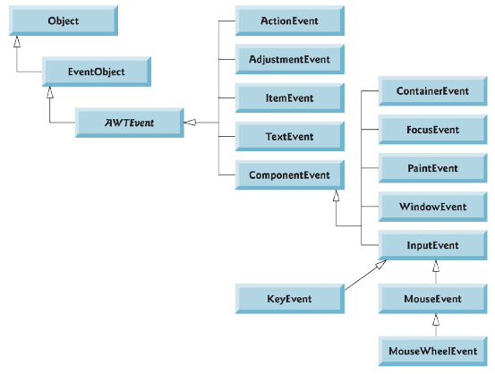
A few class in java.awt.event

Slide 25
How it happens
How does the GUI component know to call action Performed rather than another method?
Every GUI component supports several event types, including mouse events, key events and others.
When an event occurs, the event is dispatched
The private classes that implement the correct type and are properly registered are called

Slide 26
Event Listeners must implement the correct interface
All event listener class must:
Implement an interface
Java provides numerous interfaces that you can use with event listener classes
The specific interface that you will use depends on the type of event you want to handle
Jbutton components generate action events, and the event listener class that can handle action events is also known as an action listener class
When you write an action listener class for a Jbutton component, it must implement an Interface known as ActionListener
What are some other interfaces?

Slide 27
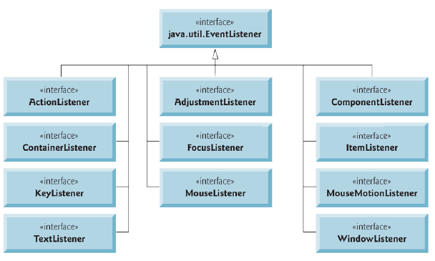
Common Event Listener Interfaces

Slide 28
Common Errors to avoid
Misspelling javax.swing in an import statement
Forgetting to specify an action when the user clicks on the Event Source
Remember that application is not terminated when you close or hide a Jframe. If you want to terminate the application, call setDefaultCloseOperation method and pass Jframe.EXIT_ON_CLOSE as the argument
Forgetting to write an event listener for each event you wish an application to respond to
Forgetting to register an event listener
When writing an event listener method that is required by an interface, not using the method header specified by the interface

Slide 29
I like this picture

Slide 30
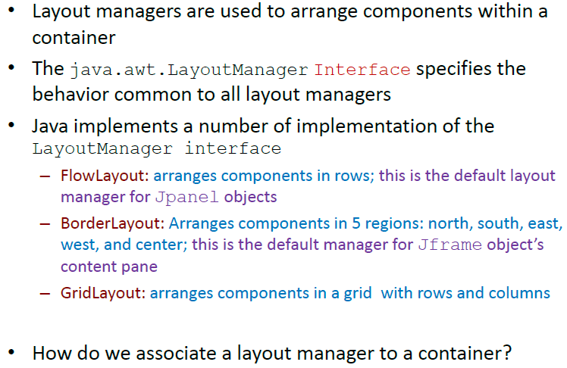
Layout Managers

Slide 31
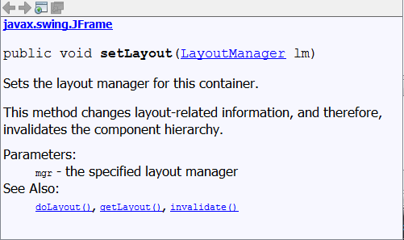
Setting the layout manager
How do you do it?
Setting it to null will allow you to program in absolute terms.

Slide 32
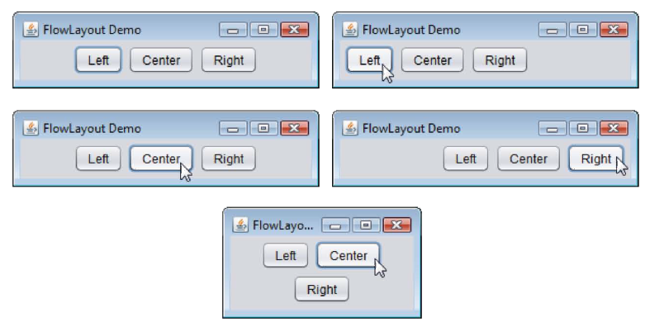
Flow Layout

Slide 33
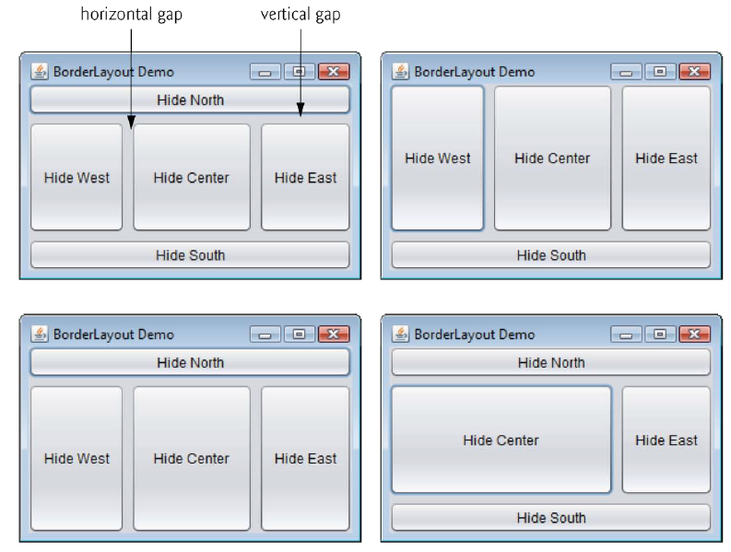
Border Layout

Slide 34
Grid Layout

Slide 35
Pop Quiz
In one sentence what is a Framework?
(Do not use an example)
What is Swing?
Does the order to which you add Java components matter in terms of how they are displayed?
List everything that happens in a properly coded GUI program when a JButton is pressed (Use the example from last class)
What are the three main Layout managers in Java?

Slide 36
Pop Quiz
In one sentence what is a Framework?
It is a process that uses specific objects
What is Swing?
Java GUI Library
Does the order to which you add Java components matter in terms of how they are displayed?
Yes
List everything that happens in a properly coded GUI program when a JButton is pressed (Use the example from last class)
An event is created
A registered ActionListener object is called
What are the three main Layout managers in Java?
Flow
Border
Grid

